Slide 1
NCEA Information

Slide 2
NCEA Level 1
Minimum of 80 credits required at Level 1 (or higher), including:
10 credits in Literacy (from a wide range of subjects), and
10 credits in Numeracy (mainly from Mathematics)

Slide 3
Credits and Standards
Courses of work (subjects) are broken into units based on skills or content knowledge. Each of these units of work has an Achievement Standard.
Each Standard attracts credits-the number of credits attached to each standard depends on such things as the depth of knowledge required, the amount of effort and time required, the complexity of skill needed.
Credits are accumulated during the year.

Slide 4
Form of Assessment
Each unit of work is assessed either as:
Internals (assessments are prepared, supervised, marked and moderated by teachers within the school), or
Externals (assessments are prepared, supervised and marked by NZQA employees).

Slide 5
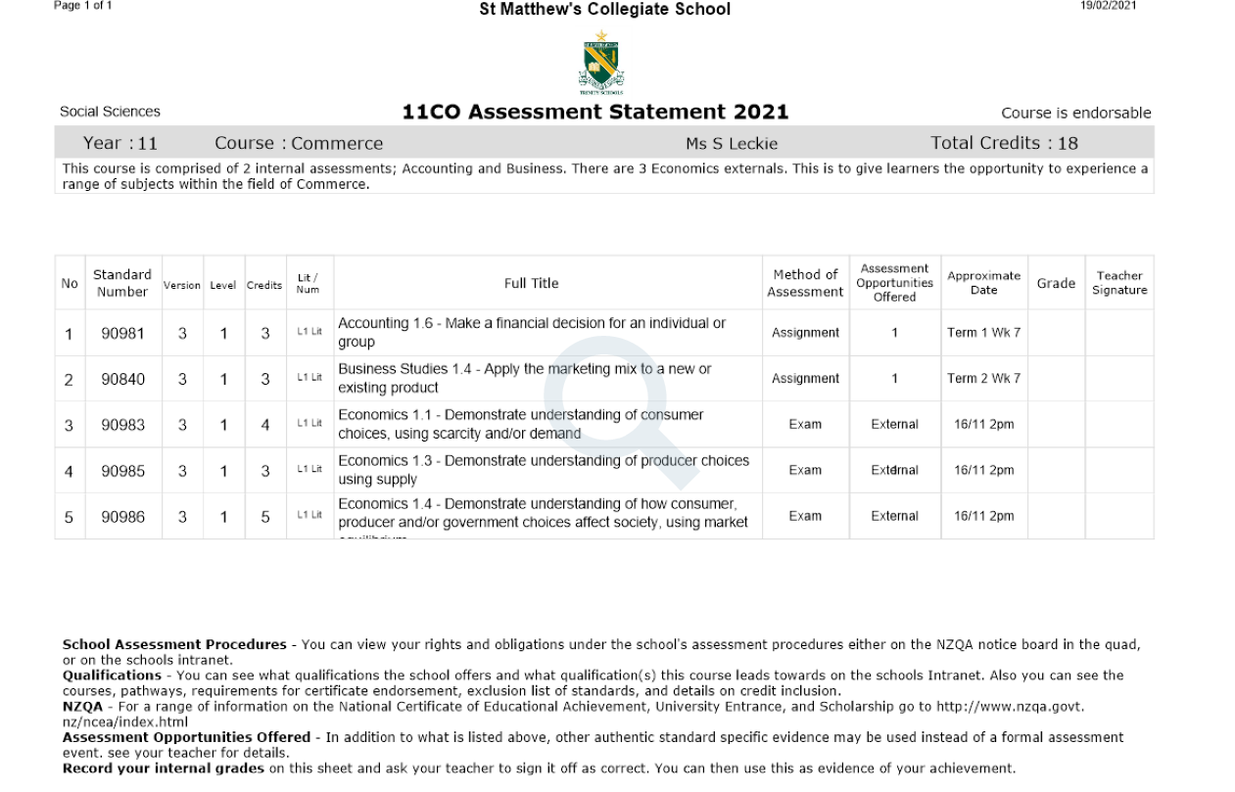

Slide 6
Grades Possible
Achievement Standards have 3 levels of achievement:
Achieved – the minimum required for success (A)
Achieved with Merit (M)
Achieved with Excellence (E)
NB: a Not Achieved grade (N) is given for students who had the opportunity to succeed but who did not reach the minimum standard for success.

Slide 7
Recognising High Achievement
Subject Endorsement
Excellence endorsement – 14 or more credits at Excellence in a single subject in a single year, including at least 3 Excellence credits from external assessment and 3 Excellence credits from internal assessment.
Merit endorsement - 14 or more credits at Merit (or a mix of Merit and Excellence) in a single subject in a single year, including at least 3 Merit credits from external assessment and 3 Merit credits from internal assessment.

Slide 8
Course (Subject Endorsement) in PE and Visual Arts
A course will be endorsed: if 14 or more credits are achieved with Merit or Excellence from internally assessed Physical Education standards or Visual Arts

Slide 9
Recognising High Achievement
Level Endorsement
Excellence endorsement – 50 or more credits from any combination of subjects achieved with Excellence
Merit endorsement – 50 or more credits from any combination of subjects achieved with Merit (or a mix of Merit and Excellence)
Note that Certificate Endorsement is not ‘year specific’ – Merit and Excellence grades earned across more than one year will all be counted. Certificate endorsements can be earned retrospectively.

Slide 10
Results – KAMAR portal
Parents and students can access NCEA results (and a range of other school data) via our database software portal
Please note that these results are not official results – these are shown on the NZQA website

Slide 11
Fees
There is no fee for entering NCEA or Scholarship exams.
The fee for International students remains as before.

Slide 12
Further Information
NZQA website: www.nzqa.govt.nz
NCEA Guide App. Available from both iTunes and the Google play store

Slide 13
